Slide 1
What is method
Ett försök att samla hop det hela
and why shall we have it?
http://perflensburg.se/samlateng.pptx

Slide 2
Method?
Systematic approaches to implementing an activity of some kind.
System development method
Programming methodology
Design method
Methodology: The study of methods and method use.
In this course we speak, however, about the scientific method.

Slide 3
Scientific method?
Are well tried and tested procedures, which are used to produce a special kind of knowledge, the Scientific Knowledge, which is characterized by high reliability and universality.
In other words: Scientific method and scientific knowledge are closely related.
But what is science - really?

Slide 4
Science and Method
Problem
Teori
Teori
Teori
Theory
Discipline
Domain
Methodology
Method

Slide 5
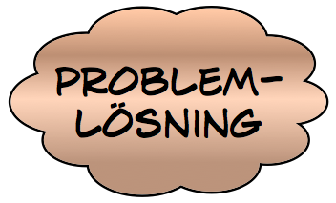
Do you benefit of method outside of science?
Theory
sci. metod
Result
Science
Consult
Result
Method
solution

Slide 6
Ingredients in methods
Description of the problem, seen from a certain perspective
General method approach (Theory of science)
Method of data collection
Method for data analysis
Method for drawing conclusions
Method for presentation of results
This is often called method

Slide 7
Science
WTF is that?

Slide 8
Science - popular definition
Scientific theories are rigorously derived from experience facts, achieved through observation and experimentation.
Science is based on what we see, hear, feel and so on.
Personal opinions and speculation has no place in science.
The science is objective.
The science is general.
Science presupposes observation without influence

Slide 9
Science
No 6
Means ”nature science" in English
For traditional nature science the criteria on the previous slide is valid
But quantum mechanics puts everything on the way because the basic assumption: "observe without affecting" (ceteris paribus) no longer apply.
This applies even more about people and social systems studied

Slide 10
Objectivity
No 1, 2, 4
How do we know that there is an objective reality, independent of us? All our knowledge of reality comes of course through our senses.
And these can be very deceptive.

Slide 11
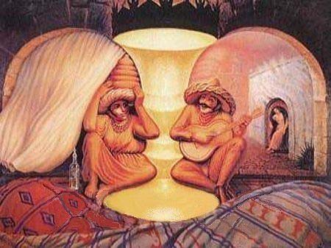
What us this?

Slide 12
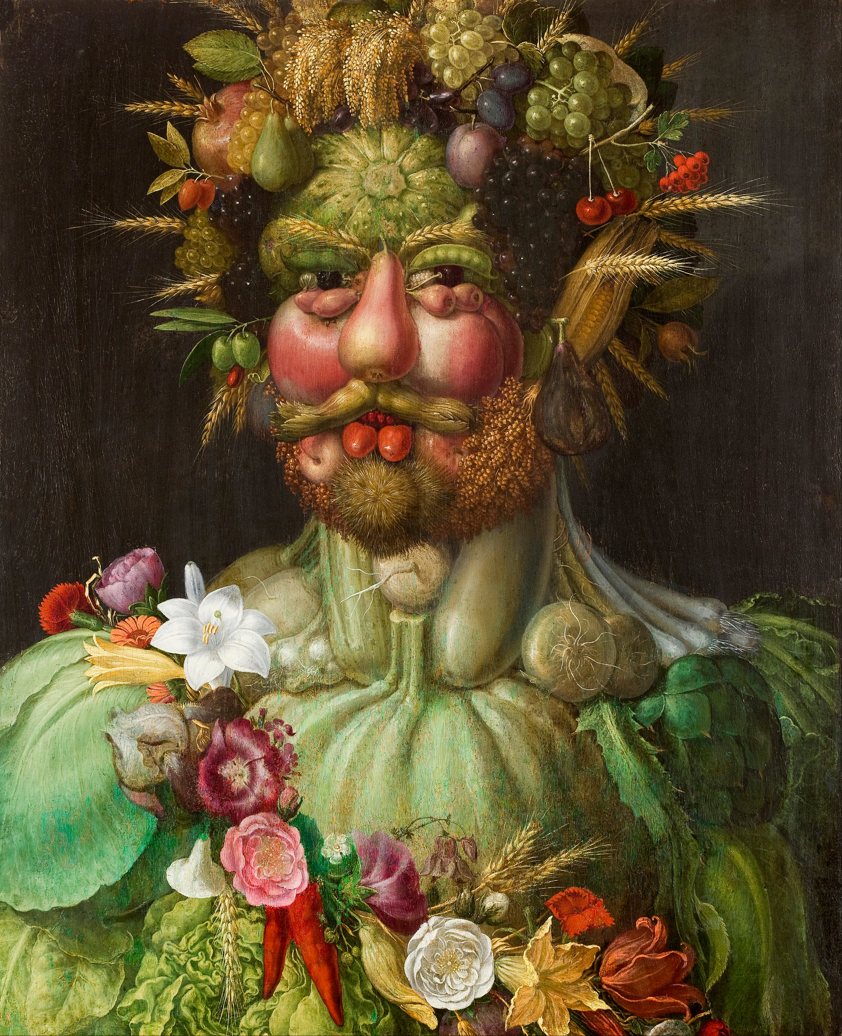

Slide 13
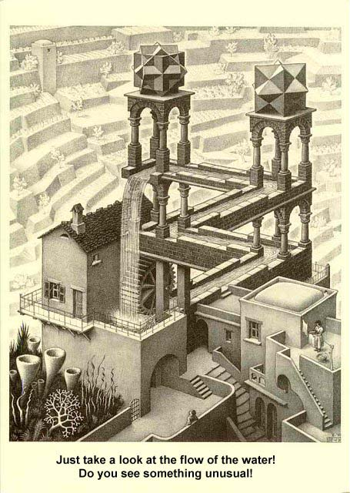

Slide 14
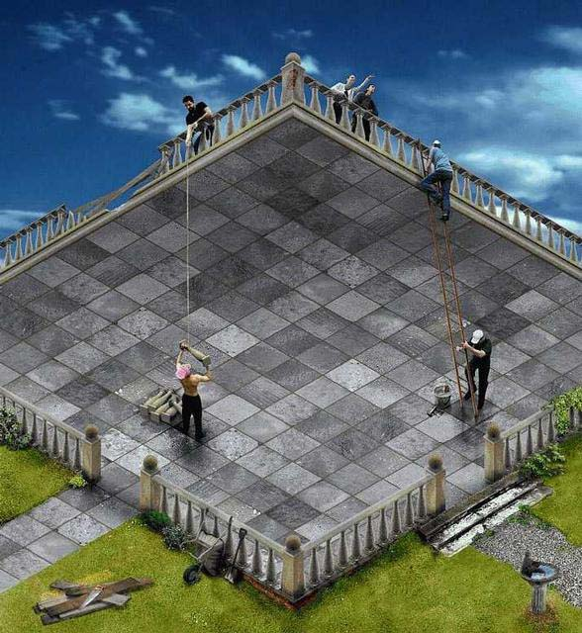

Slide 15
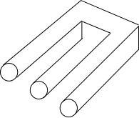

Slide 16
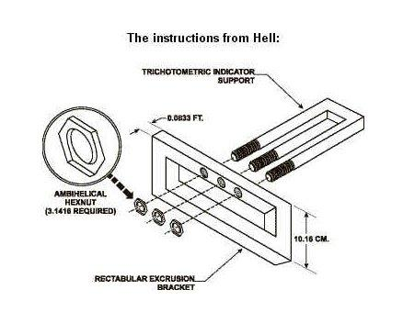

Slide 17
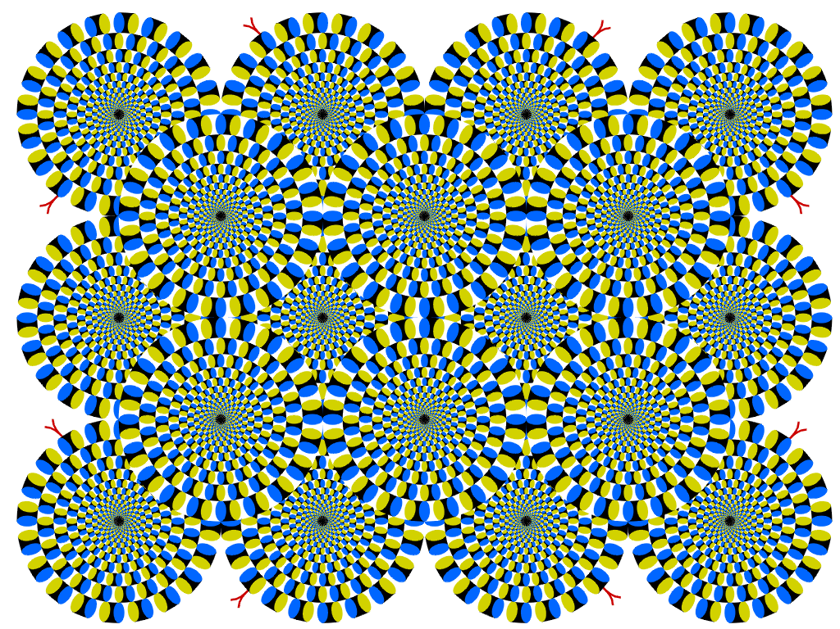

Slide 18
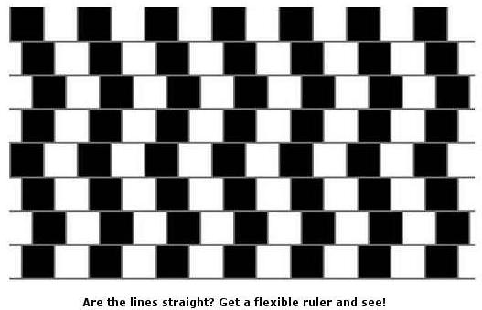
Ullamcorper Lorem Ridiculus

Slide 20
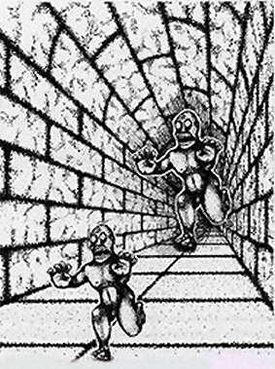

Slide 21
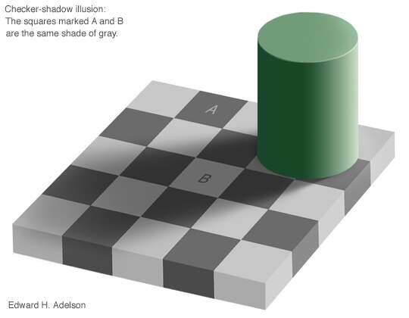
Ullamcorper Lorem Ridiculus

Slide 22
Answer as fast as possible
1+5
2+4
3+3
4+2
5+1
Say the number six to yourself as many times as possible in 15 seconds
Quick: Think of a vegetable!
You thought of a cucumber!
Or carrot!

Slide 23
Scientific explanations
Often based on cause and effect, manifested by interacting variables.
Ex: If you smoke, chances of getting lung cancer is high!
Variabel
Variabel
Variabel
dependent variable
Variabel
Variabel
Variabel
Independent variables

Slide 24
Variables?
What is a variable?
It is given by the theory which describe the domain as a number of concepts.
The scientific survey mission is:
To prove the validity of the theory in the study area (hypothesis testing)
To extend the existing theory with new concepts or new areas

Slide 25
Variable analysis
It goes without saying that it is often very intricate relationship between these variables.
Reducing them to a few connection is a difficult and problematic simplification.
Therefore, science is engaged with phenomena that can be simplified in an easy way.
Trivialities it is called in everyday life .

Slide 26
But why do have you science?
Instead of "absolute knowledge" you can say "as general knowledge as possible"
Or delimit to a specific context and only statements about this.
The problem is known as "rigor vs. relevance"
Scientific knowledge will help us to better understand (and control?) our world.
We get new concept that describes the unknown aspects.

Slide 27
Scientific process – ideal
One observes reality and find some regularities.
These regularities is named and you study their relationship to other known phenomena.
Once this is understood, our knowledge of reality has slightly increased.
This is what I consider as the optimal scientific process

Slide 28
Other characteristics
Scientific knowledge is available to evrybody and costs nothing.
The scientific process is open and free for everyone to get insight into.
Everyone should be able to check my results by repeating my investigation.
For this to be possible, a methodical and careful approach is needed, ie scientific method!
Cf. quality, type ISO 9000!

Slide 29
Disadvantages of method
Scientific method is thus well-tried and tested approach.
This means that innovation and creativity are not possible in terms of methodology.
This means that the groundbreaking new discoveries can never be done if you follow the methods!
History also shows that all the great discoveries have been made when scientists broke the rules!

Slide 30
Conclusion
Scientific freedom and independence requires a methodical approach
The method is also a quality assurance
But it guarantees no great, fundamental discoveries.
Actually it prevent such!
But breaking the rules is no guarantee of great discoveries.

Slide 31
Truth
An important and difficult concept

Slide 32
Truths
There are different truths:
Correct <=> consistent with reality, opposite "incorrect"
True <=> logical truth, opposite "false"
Right <=> Moral truth, opposite the "wrong"
Often you mix them!
This is not good!

Slide 33
Logical truth
Considered fundamental to all scientific activity.
Can ultimately be traced to what is called propositional logic.
This means only the manipulation of symbols according to rules set in the logic.
However, there is no connection to reality; logic can not bring us knowledge of it!

Slide 34
What is...
1 + 1
= 2
+

Slide 35
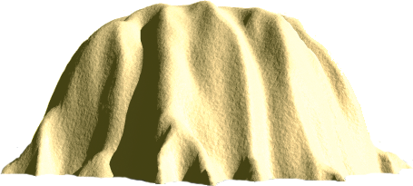
Well....

Slide 36
Correct
No 3, 5
"It's snowing outside right now" may be correct.
"There is snow on the ground" is meaningless in Sami, as the term "snow" does not exist. They have instead 62 different concepts for ”snow”
If the sun is shining and I say it is beautiful weather protesting a person from Somalia. For them it is beautiful weather when it rains.
The accuracy depends on the language and worldview (Weltanschaung).

Slide 37
Right
For the Nazis, it is right to kill a Jew.
In some places it is right to kill a condemned criminal.
But was it right to conduct the research that made it possible to construct the atomic bomb?
Is it right to do research on nonsense? For example. how to shorten the color "blue" in the program code.

Slide 38
Objective truth
No 4
Available in logic
But not in reality (possibly in a small part of it)
Nor in morality
Though some fundamental believers claim it ...
In all cases (including logic) you have to agree on the starting points and preconditions.
These constitute Weltanschauung

Slide 39
Universal knowledge
No 5
Scientific knowledge must be valid everywhere and always.
This means that it will be very watered down ...

Slide 40
Social Science
With a hefty dose of theory of science

Slide 41
ethics
World view
epistemology
ontology
world view
human view
Organization view
IS development model
IS development process
Information system
work

Slide 42
Different methodologies
theory of science
Objektivism
Positivism
Empirism
Realism
Subjektivism
Idealism
Feminism
Problem
Teori
Teori
Teori
Teori
Ämne
Domän
Metodologi
Metod

Slide 43
Subjectivism
Objectivism
Idealism
Realism
Empirism
Positivism
Hermeneutics
phenomenology

Slide 44
Objectivism
Objectivity means factuality and impartiality.
Objectivity substantiate, refute, structures or generates our theories
It produces results that can challenge not only our perceptions but also those that generally apply in society.

Slide 45
Objectivism (cont.)
It is a common assumption that if our values are not interfering in our research, it is objective and above any form of criticism.
The basic belief is that there must be some permanent, ahistorical sources or structures that we may ultimately fall back on when it comes to determining the meaning of rationality, knowledge, truth, reality, the good or the right

Slide 46
Positivism
Positivism is an anti-metaphysical epistemology.
According to it, we can generalize from our observations of social phenomena and formulate statements that are valid for the behavior of the population as a whole.
Based on his model positivism explains human behavior in terms of cause and effect.

Slide 47
Empiricism 1
Positivism has the same perception as empiricism in the sense that both directions believe that there are "facts" that we can gather from the social world, regardless of how people themselves interpret them.
As scientists we just need to refine our tools for data collection so that they are neutral recording instruments.ccc

Slide 48
Empirism 2
The fundamental difference between empiricism and positivism is on the theoretical plane.
Within positivism, the data is "theory-controlling ': Data will be a test of the theory's validity.
Empiricism lacks the theory that control the collection of data.

Slide 49
Empirism 3
Empiricism refers to an idea of social research where the emphasis is on the production of accurate data - accurately determined, precise and generalizable - and where the data itself is the target of the research. This view is summarized in the slogan "the facts speak for themselves."

Slide 50
Empirism 4
It is assumed that there is a world out there that we can record and analyze independently of people's interpretations of it.
It works from the so-called "correspondence theory of truth," which means that an idea or a proposition is true if there is an external fact which corresponds to it.

Slide 51
Realism 1
The realistic tradition share the positivist approach that science's goal is to find explanations, but there the similarities end.
A realist adhere to the existence of certain undisputed categories such as material objects, universals, causal laws, numbers, probabilities, rationality, social structures and moral facts.

Slide 52
Realism 2
The underlying structural mechanisms determines what we can see and observe.
The researcher's task is to lay bare the structure of social relations to understand why we have the institutions and practices that we have.
Ex: Talcott Parsons structuralism in sociology

Slide 53
Realism 3
The task of the social researcher is
to gather facts about the social world
explain these facts on the basis of the underlying mechanisms that structure people's actions and prevent their choices from being realized
Ex: The school function under capitalism is to reproduce the labor force.

Slide 54
Subjectivism 1
We can only gain knowledge of the world through the subjective experiences
Through these we attribute the surroundings a meaning
A subjectivist does not study the environment itself, only the personal interpretation of the same.

Slide 55
Subjectivism 2
We can not as scientist - as positivism claims - reach knowledge of people's surroundings regardless of their interpretations
The only thing we can know with certainty is how we interpret the world around us.
As researchers, our interest has focused on the understanding and interpretation of the social environment.
But how to communicated it and make it more general???

Slide 56
Idealism 1
Idealism emphasizes how we as people ourselves create the social world through our ideas and that we are not just a product of it.
The claim is that our actions are governed by the rules we use to interpret the world.
Because the natural sciences study objects that have no "consciousness", they say within idealism that you can not use only nature science methods to study social life.

Slide 57
Idealism 2
You can not talk about cause and effect when investigating human social life, since man as being - unlike molecules - reflect, interpret, and act in their environment.

Slide 58
Hermeneutics 1
Deals with interpretation. You experience or observe certain phenomena in the world. These are interpreted in order to understand and explain (not in cause-effect terms) the world
You always have certain ideas about the world before you observe; this is called pre-understanding
The apprehension of the world is constructed in a social interaction – also historically

Slide 59
Hermeneutics 2
The results of scientific investigations are not absolut truths, but they are valid for the studied community
The understanding should be general insofar as it can be applied in other cases which not need to be similar
The hermeneutician studies and interpret the reality, but never intervenes.

Slide 60
Phenomenology 1
Our apprehension of reality is continuously shaped and reshaped in a social interaction with other people
In phenomenology you want to capture the experience of a phenomenon. You will without distortion describe the experience of a phenomenon as it turns out the informants.
Note: the scientist who asks questions is part of the informant's life world and this affects the results.

Slide 61
Phenomenology 2
In phenomenology you tries to avoid interpretations of experiences. The goal is to present the life-world as it turns out without reinterpretations.
An important subsection to achieve this freedom of interpretation is that the researcher put their own understanding aside and then the researcher can see the informant's life-world emerge.
But is this possible?

Slide 62
Phenomenology 3
Essence is in the intentional structure which does not vary between individuals.
If you have managed to capture and describe the true essence you will see all the different varieties found in the intentional structure are different variations of this essence.
In some studies you find no one essence. It is then a question whether it is because there really is no essence or if the study is bad (bad or poor basic data analysis?).

Slide 63
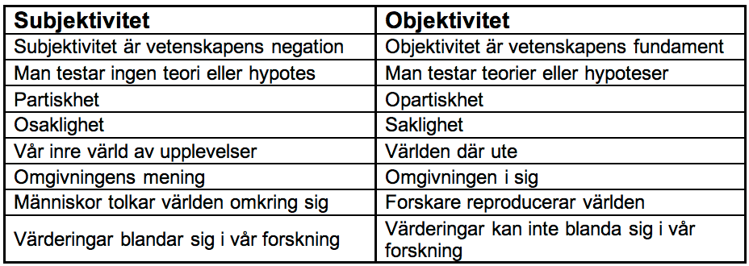
Subjectivity & Objectivity

Slide 64
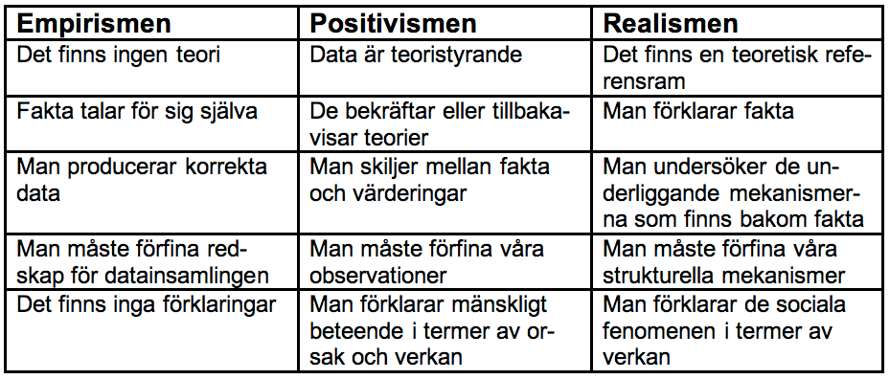
Empirism, positivism o realism

Slide 65
From philosophy to approach
Ontology
Epistemology
Subjektiv<=>Objective
world view
Understand <=> cause / effect
235
Forskningsansats
Metodansats
Forskningsansats
Methods
Metodansats
Forskningsansats
Methods
methodologies
Forskningsansats
Methods
Research approach
How do we do?
what do we do?
(the -isms)

Slide 66
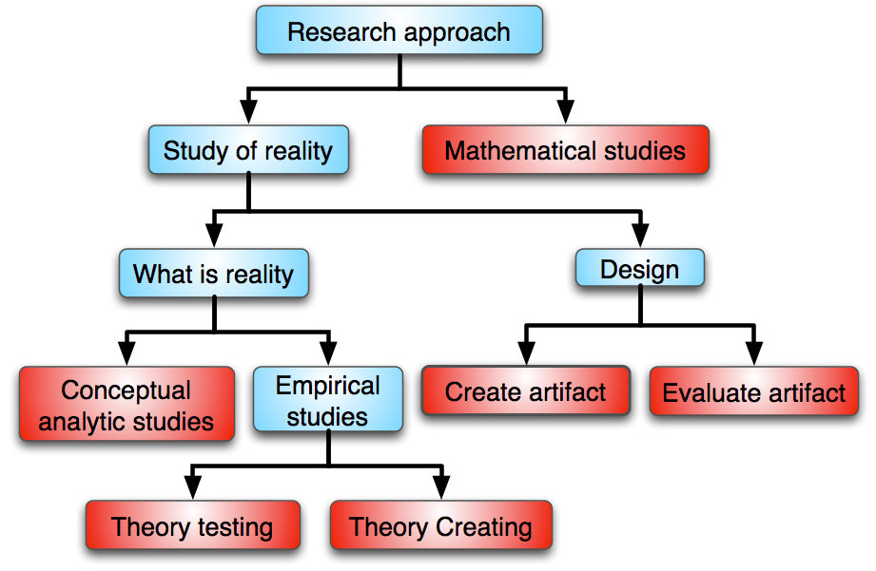
Research approach
Pertti Järvinens modell
75%

Slide 67
world view
theory of science
Knowledge process
Knowledge process
Knowledge process
Knowledge process
research approach
increased concretization
data collection methods
case study survey interview…
induction - deduction
quantitative - qualitative
???

Slide 68
Finito!

